Slide 1

22ECAC210
Exploratory Data Analysis Course Project: Phase - 3 Review
Equity in Healthcare: Tackling the differences between socio-economic aspects and health equity
Department of Computer Science and Engineering,
KLE Technological University’s Dr. M. S. Sheshgiri College of Engineering and Technology, Belagavi

Slide 2
Details of the Team
Team No. |  | EDA-D3
Div: |  | D
Sl. No. | Name |  | SRN.
1 | Soham Mali |  | 02FE22BCI025
2 | Manish Sabnis |  | 02FE22BCI026
3 | Snehal Gujjar |  | 02FE22BCI046
4 | Shreya Rokade |  | 02FE22BCI042
Department of Computer Science and Engineering,
KLE Technological University’s Dr. M. S. Sheshgiri College of Engineering and Technology, Belagavi

Slide 3
Motivation: The Motivational Factors are 1.Human Rights and Dignity 2.Economic benefit 3.Social Stability and Development 4.Global Health Security 5.Sustainable Development 6.Innovation and Progress
Our project falls in the SDG3 i.e., Good Health and Well-being SDG.
The SDG3 is one of the 17 goals established by the United Nations in 2015 as part of the 2030 Agenda for Sustainable Development
The SDG3 aims to ensure healthy lives and promote well-being for all, at all ages
Department of Computer Science and Engineering,
KLE Technological University’s Dr. M. S. Sheshgiri College of Engineering and Technology, Belagavi

Slide 4
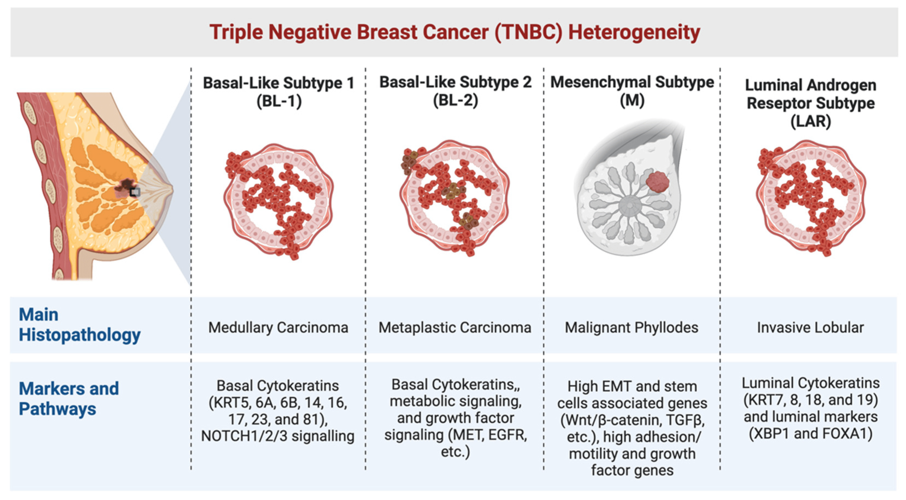
Background
Problem Statement
Given a patient’s socioeconomic and demographic details, build a predictive model that can accurately predict the time it takes for the patient to get a diagnosis of the metastasis of the TNBC. Find the relationship of the diagnosis period with the zip code-level climate patterns. Find if any biases played a role in getting the patient her quick diagnosis and timely treatment.
Department of Computer Science and Engineering,
KLE Technological University’s Dr. M. S. Sheshgiri College of Engineering and Technology, Belagavi

Slide 5
Dataset Details
A training and test set of about 19k records, representing patients and their characteristics (age, race, BMI, zip code), diagnosis and treatment information (breast cancer diagnosis code, metastatic cancer diagnosis code, metastatic cancer treatments, etc.), geo-demographic data (income, education, rent, race, poverty, etc.) at the zip-code level, and climate data that links health outcomes to environmental factors are the main focus of the WiDS Datathon 2024. Each patient and her diagnosis period are represented by a row in the data. It is your responsibility to forecast the patient's Metastatic Diagnosis Period in the Test Dataset based on the attributes and details supplied. Some data might not be as clean as data from the real world.
The WiDS Datathon 2024 focuses on a prediction task using a roughly 19k record dataset (split into training and test sets) representing patients and their characteristics (age, race, BMI, zip code), their diagnosis and treatment information (breast cancer diagnosis code, metastatic cancer diagnosis code, metastatic cancer treatments etc.), their geo (zip-code level) demographic data (income, education, rent, race, poverty etc), as well as climate data that tie health outcomes to external conditions. Each row in the data corresponds to a single patient and her Diagnosis Period. Our task is to predict the patient's Metastatic Diagnosis Period in the Test Dataset using the provided characteristics and information about the patient. Some data may be messy to reflect real-world data. Our expectation is that we will address messy data issues through appropriate means.
Source URL:
https://www.kaggle.com/competitions/widsdatathon2024
Department of Computer Science and Engineering,
KLE Technological University’s Dr. M. S. Sheshgiri College of Engineering and Technology, Belagavi

Slide 6
Knowing the Dataset
Our Dataset is split into the Train Dataset and the Test Dataset.
1. Train Dataset
• The Train dataset consists of 13173 entries with 152 attributes.
• The data types are float64 (137 columns), int64 (4 columns), and object (11 columns).
• The memory size is 15.3 MB
2. Test Dataset
• The Test dataset consists of 5646 entries with 151 attributes.
• The data types are float64(137 columns), int64 (3 columns), and object(11 columns).
• The memory size is 6.5 MB
Department of Computer Science and Engineering,
KLE Technological University’s Dr. M. S. Sheshgiri College of Engineering and Technology, Belagavi

Slide 7
Empathy
Impacts of Ill Health:
The impacts of ill health on individuals and society are intense and sophisticated.
The individuals suffering from TNBC, due to poor health can lead to diminished quality of life, which increases medical expenses.
This will further result in Financial stress and loss of income due to inability to work.
From a Societal perspective Ill health can burden health care systems, leading to higher national healthcare costs.
Overall the common effects of ill health underscore the importance of robust public health initiatives and access to quality health care for all.
Department of Computer Science and Engineering,
KLE Technological University’s Dr. M. S. Sheshgiri College of Engineering and Technology, Belagavi

Slide 8
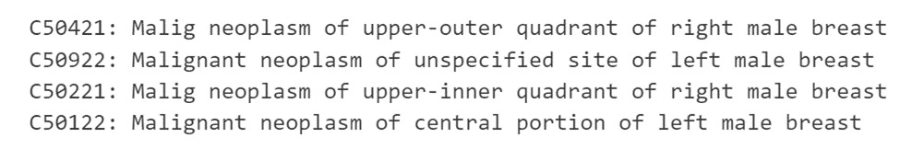
Data Pre-processing
Data Preprocessing is a crucial step that needs to be performed in Data Analysis. It involves Cleaning, Transforming, and Organizing Raw data into a suitable format.
1. Data Cleaning
- NLP-based Replacement: Here we have used Natural Language Processing (NLP) Techniques to replace any incorrect descriptions and their equivalent cancer codes with female cancer descriptions and respective cancer codes from the ICD10 website.
#-_column `breast_cancer_diagnosis_desc` contained incorrect values like male cancer descriptions:-
#replacing these cancer codes with their corresponding female codes:-
{'C50421': 'C50411', 'C50922': 'C50912', 'C50221': 'C50912', 'C50122': 'C50112'}
Department of Computer Science and Engineering,
KLE Technological University’s Dr. M. S. Sheshgiri College of Engineering and Technology, Belagavi

Slide 9
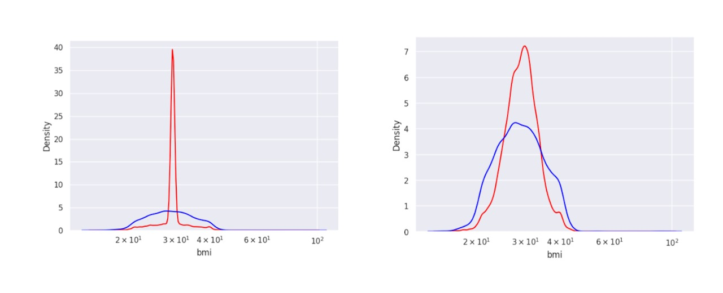
Data Pre-processing
2. Data Transformation
• Imputation with Mean: Here we imputed Missing Values with Mean.
• By imputing with mean values we notice that the BMI column exploded.
• So, Now we try imputing values with KNN imputation and apply the same for categorical columns.
Department of Computer Science and Engineering,
KLE Technological University’s Dr. M. S. Sheshgiri College of Engineering and Technology, Belagavi

Slide 10
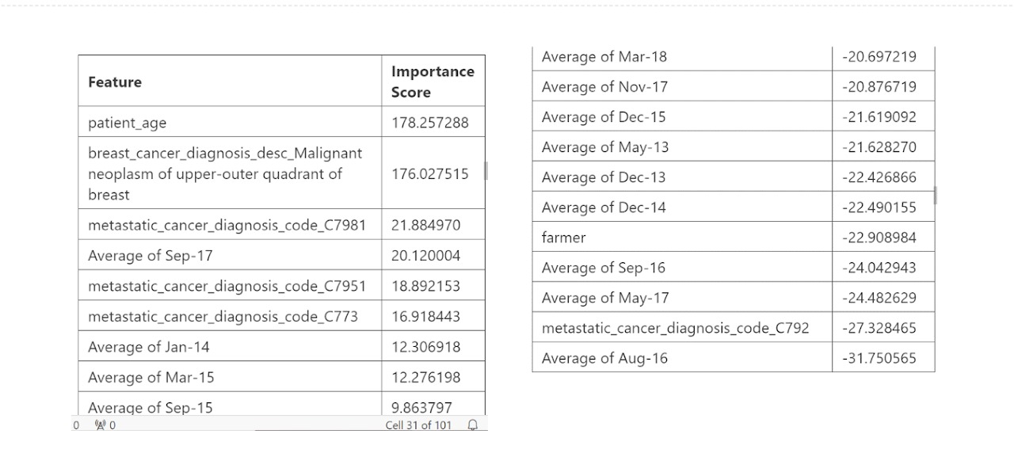
Data Pre-processing
3. Feature Engineering
LOFO(Leave One Feature Out) calculates the importance of features and guides us in deciding which column to drop.
We used LOFO importance to calculate important columns and dropped the columns that had a negative importance Mean score
Department of Computer Science and Engineering,
KLE Technological University’s Dr. M. S. Sheshgiri College of Engineering and Technology, Belagavi

Slide 11
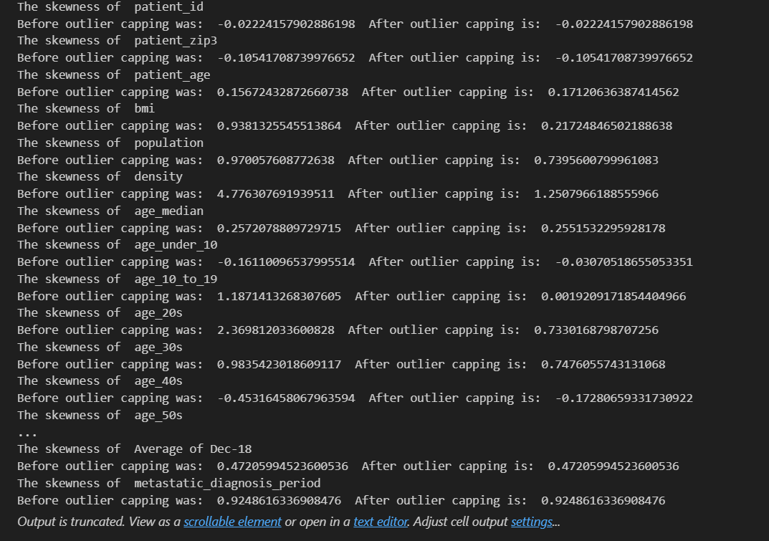
Data Pre-processing
4. Capping Outliers
• We capped the outliers with extreme values in the dataset that can skew the model performance.
• By capping the outliers the extreme values will fall within a suitable range which in turn will improve the Reliability and Accuracy of our Model.
Department of Computer Science and Engineering,
KLE Technological University’s Dr. M. S. Sheshgiri College of Engineering and Technology, Belagavi

Slide 12
Data Pre-processing
6. Encoding Categorical Columns
There are various Encoding methods such as One-hot Encoding, Binary Encoding, Frequency Encoding, Integer Encoding, etc.
We opted for One-hot Encoding method for the Categorical Columns, making them suitable for Machine Learning Algorithms.
Categorical columns:
1.'patient_race’ 11.'metastatic_first_novel_treatment_type'
2.'payer_type'
3.'patient_state'
4.'Region'
5.'Division'
6.'patient_gender'
7.'breast_cancer_diagnosis_code'
8.'breast_cancer_diagnosis_desc'
9.'metastatic_cancer_diagnosis_code'
10.'metastatic_first_novel_treatment'
Department of Computer Science and Engineering,
KLE Technological University’s Dr. M. S. Sheshgiri College of Engineering and Technology, Belagavi

Slide 13
Proposed Hypothesis
1.Given that patients are mostly ordinary people, the fact that the commercial payer type is dominant in the dataset indicates that most patients prefer private insurance, indicating that most patients are predominantly ordinary people who do not enjoy any government benefits.
2) Why so? How can you prove it?
A LOFO importance model was plotted that indicates that the occupations like farmer or veteran had negative importance mean on the target variable which brings us to a theory that the diagnosis period did not depend on the occupation that dominated the state or the region the patient is from and which explains why commercial payer type is dominant because most farmers or veterans use Medicaid or Medicare-Advantage payer type.
Department of Computer Science and Engineering,
KLE Technological University’s Dr. M. S. Sheshgiri College of Engineering and Technology, Belagavi

Slide 14
Proposed Hypothesis
3. How can you prove that insurance played a role in determining the diagnosis period?
The LOFO model shows a positive importance mean of 'uninsured health' attribute of the patient's region with the target variable meaning if a patient lived in region with higher uninsured health clients, it probably affected the diagnosis period of the patient.
4. So who are these patients?
The LOFO models shows a higher importance mean for the education_bachelors attribute which means that the diagnosis period of the patient was dependent on how high the people in the patient's region are educated. Since most Americans have a bachelor degree, it could simply mean that areas It could be that these people must have advised the patient to not opt for certain tests that may have prolonged the diagnosis period, or maybe otherwise.
Department of Computer Science and Engineering,
KLE Technological University’s Dr. M. S. Sheshgiri College of Engineering and Technology, Belagavi

Slide 15
Proposed Hypothesis
5. Does that mean that the patients were uneducated or perhaps not from the USA?
Patients education was not specified in the dataset but it could be that the patients may have not been from the USA originally. They could be migrants as the LOFO importance model shows that the race of the patient influence the target variable as well.
6. What else indicates that the patients were not from USA?
The dependence of the diagnosis period on the attribute 'limited english', as shown by the LOFO model, means that the patients may have not been from USA.
Department of Computer Science and Engineering,
KLE Technological University’s Dr. M. S. Sheshgiri College of Engineering and Technology, Belagavi

Slide 16
Proposed Hypothesis
7. Could there be a possibility that the dataset is biased?
There seems to be no possibility that the dataset is biased. The OLS Model shows that races like Black or Hispanic occurred frequently in the dataset meaning that patients identified as Black or Hispanic.
8. How was the dependence of the diagnosis period on the patients health?
As shown by both, the LOFO model, the scatter plot and the OLS model, the patient's BMI did not play any role in the diagnosis period of the patient which could be true since BMI could be important in determining if a patient has cancer or not, it may not be important in predicting how long it took for the patient to get diagnosed. It is also scientifically proven that BMI is not a good measure of health as it does not assess body fat, muscle fat and bone density.
Department of Computer Science and Engineering,
KLE Technological University’s Dr. M. S. Sheshgiri College of Engineering and Technology, Belagavi

Slide 17
Proposed Hypothesis
9. So in terms of patient's health, what contributed to the diagnosis period?
Patient's age showed a significant dominance with the target variable. This could be due to the tests that may have been excluded if not for the patient's age.
10. Is the BMI dependent on the patient's age?
No. The scatter plot shows no relationship between age of the patient and her BMI.
Department of Computer Science and Engineering,
KLE Technological University’s Dr. M. S. Sheshgiri College of Engineering and Technology, Belagavi

Slide 18
Proposed Hypothesis
11. And what about the marital status?
Patients marital status was not specified in the dataset, but the marital statuses of the people in the patient's region played an important role in determining the diangosis period. With statuses like 'married', 'never married', 'widowed' or 'divorced' playing an important role in determining how quickly the patient was diagnosed. This may be because the patient is involved in some community activities that could postpone the tests that the patient was scheduled for.
12. If marital status played a role in the diagnosis period of the patient, does that mean the family size did as well?
No. The average family size of the patient's region did not determine the diagnosis period of the patient.
Department of Computer Science and Engineering,
KLE Technological University’s Dr. M. S. Sheshgiri College of Engineering and Technology, Belagavi

Slide 19
Proposed Hypothesis
13. So how did the people in the region of the patient affect the diagnosis period?
The average household income of the patient's region influence the diagnosis period. Like what hypothesis 1 says, most patients are middle-classes, earning between $35k - $155k (per SmartAsset.com). So the regions with family incomes that lie between that range played a role in the diagnosis period of the patient as shown by the OLS Model.
14. In terms of the cancers, who was responsible in the late or quick diagnosis period of the patients?
Both the cancer codes and diagnosis descriptions of the patients were responsible for the diagnosis periods of the patients as shown by the OLS, LOFO models. This could be because of the mutations of each cancers that could have required more or less tests to get a diagnosis done.
Department of Computer Science and Engineering,
KLE Technological University’s Dr. M. S. Sheshgiri College of Engineering and Technology, Belagavi

Slide 20
Proposed Hypothesis
15. So their cures played a role too?
No. Both, the OLS and LOFO model showed that the treatments did not play a role in the diagnosis period of the patient. Infact the treatment and the treatment types had heavy missing values and had no effect on the target variable
16. What else played a role in diagnosing a patient?
The average temperatures of the regions played a role in diagnosing the patient. As shown by the LOFO model and the objective of the dataset, average temperatures did play a role in diagnosing a patient. Maybe due to extreme heat or extreme cold, patients postponed their tests.
Department of Computer Science and Engineering,
KLE Technological University’s Dr. M. S. Sheshgiri College of Engineering and Technology, Belagavi

Slide 21
Implementation Framework
Project Research
Data Analysis
Statistical Analysis
Data Preprocessing
Univariate and Multivariate Analysis
Model Selection
Performance Analysis
Department of Computer Science and Engineering,
KLE Technological University’s Dr. M. S. Sheshgiri College of Engineering and Technology, Belagavi

Slide 22
Project Research
• Gather Domain Knowledge and Relevant Information.
• Review Literature and Existing Solutions.
• Define the Project’s Deliverables.
Department of Computer Science and Engineering,
KLE Technological University’s Dr. M. S. Sheshgiri College of Engineering and Technology, Belagavi

Slide 23
Data Analysis
Understand the Dataset to gain Insights.
• Perform initial Exploratory Data Analysis(EDA)
• Summarize Data with Descriptive Statistics.
Department of Computer Science and Engineering,
KLE Technological University’s Dr. M. S. Sheshgiri College of Engineering and Technology, Belagavi

Slide 24
Statistical Analysis
Apply Statistical Methods to understand the data patterns and relationships.
Calculation of key statistical measures (Mean, Median, Standard Deviation, Correlation)
Conduct Hypothesis test to Validate Assumptions.
Department of Computer Science and Engineering,
KLE Technological University’s Dr. M. S. Sheshgiri College of Engineering and Technology, Belagavi

Slide 25
Data Preprocessing
Preparing Data suitable for Analysis and Modeling.
Cleaning the data by handling Missing values, Outliers, Inconsistent Data.
Encoding Categorical Variables (One-Hot Encoding)
KNN Imputation Technique.
Department of Computer Science and Engineering,
KLE Technological University’s Dr. M. S. Sheshgiri College of Engineering and Technology, Belagavi

Slide 26
Univariate and Multivariate Analysis
Examining the data in depth and understanding the relationships between variables.
Conduct Univariate Analysis to understand individual variable distributions.
Conduct Multivariate analysis to explore Interactions and Correlations between multiple variables.
Department of Computer Science and Engineering,
KLE Technological University’s Dr. M. S. Sheshgiri College of Engineering and Technology, Belagavi

Slide 27
Model Selection
Define the criteria for model selection (i.e., accuracy, interpretability, computational efficiency)
Experimenting different Algorithms (i.e., regression, decision trees, SVM, Gradient Boosting Machines)
Selecting the best performing model on Evaluation Metrics.
Department of Computer Science and Engineering,
KLE Technological University’s Dr. M. S. Sheshgiri College of Engineering and Technology, Belagavi

Slide 28
Performance Analysis
Validate the models on Test Dataset.
Calculate Performance metrics.
Analyze residuals or errors to identify any patterns or biases
Department of Computer Science and Engineering,
KLE Technological University’s Dr. M. S. Sheshgiri College of Engineering and Technology, Belagavi

Slide 29
Implementation Flow
Project Research
Data Analysis
Statistical Analysis
Data Preprocessing
Performance Analysis
Model Selection
Univariate and Multivariate Analysis
Department of Computer Science and Engineering,
KLE Technological University’s Dr. M. S. Sheshgiri College of Engineering and Technology, Belagavi

Slide 30
MOOC Course Details
Team No. : EDA-D3
Div: D
Sl. No. | Name | SRN. | Course Name | Course Link | Status
1 | Soham Mali | 02FE22BCI025 | Python 101 for Data Science | https://courses.cognitiveclass.ai/certificates/c4707266f46a4323b86e79b593d69046 | Completed
2 | Manish Sabnis | 02FE22BCI026 | Complete Data Science Boot camp | https://www.udemy.com/course/the-data-science-course-complete-data-science-bootcamp/?couponCode=LETSLEARNNOWPP | Completed
Department of Computer Science and Engineering,
KLE Technological University’s Dr. M. S. Sheshgiri College of Engineering and Technology, Belagavi

Slide 31
MOOC Course Details
Team No. : EDA-D3
Div: D
Sl. No. | Name | SRN. | Course Name | Course Link | Status
3 | Snehal Gujjar | 02FE22BCI046 | Python for Data Science | https://www.udemy.com/course/python-data-science-master-course/?couponCode=LETSLEARNNOWPP | Completed
4 | Shreya Rokade | 02FE22BCI042 | Python for Data Science | https://www.udemy.com/course/python-data-science-master-course/?couponCode=LETSLEARNNOWPP | Completed
Department of Computer Science and Engineering,
KLE Technological University’s Dr. M. S. Sheshgiri College of Engineering and Technology, Belagavi

Slide 32
Thank you !
Questions and Answers
Department of Computer Science and Engineering,
KLE Technological University’s Dr. M. S. Sheshgiri College of Engineering and Technology, Belagavi

